Slide 1

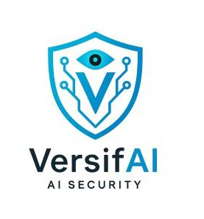
AI Security Aspects Across the AI Lifecycle
Understanding Security Impacts and Mitigation Strategies Presented by : Reem AL-ZOUHBY
July 28, 2025

Slide 2
Presentation Plan
What is AI vs What is an AI System?
Model Security vs System Security
From Data to Deployment: Securing Your AI Every Step of the Way

Slide 3

?
AI Vs AI System
Are the same thing ?
Let’s explore…

Slide 4

What is AI?
AI=the capacity of machines and computer programs to perform functions that would typically require human intelligence.
Activities include:
Education.
Medical .
Choosing.
We use it in :
Voice recognition systems, image categorization, and NLP.

Slide 5
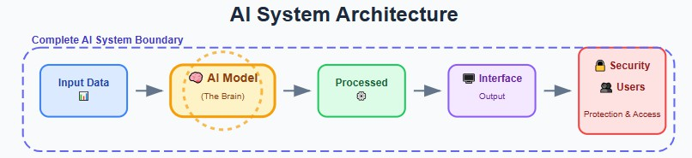
What is an AI System?
The AI enter into a real world
It’s not just the AI model ,it includes: Input data sources
Processing units (hardware, cloud, etc.) Interfaces (APIs.. )
Deployment environment (cloud, edge, local)
User access and control

Slide 6
?
What’s more important to secure ?
Model or the whole system it lives in
Let’s find out!

Slide 7
Model Security vs System Security
Model security focused on protecting the AI model itself Threats :
Data poisoning during training Adversarial examples during inference Model theft(exp: reverse engineering )
Mitigations:
Train on verified , clean dataset
Apply adversarial training and robustness testing Use watermarking or model encryption

Slide 8
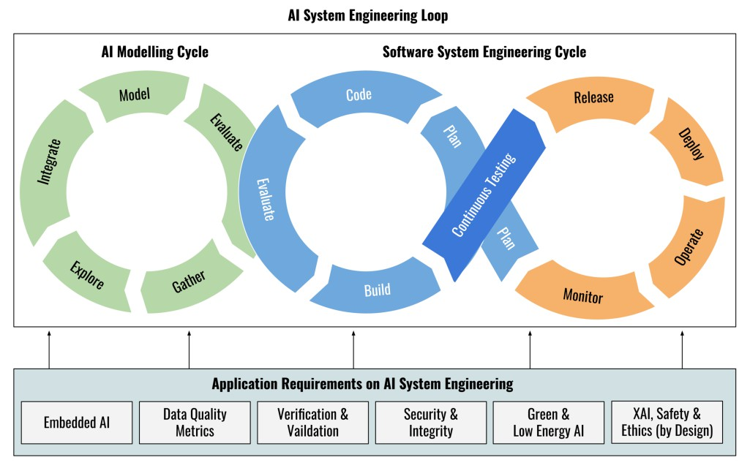
System Security: Focused on the full AI infrastructure and operations
Threats
API misuse or injection attacks
Unauthorized user access (internal or external) Model drift in production
Mitigations:
Secure connections (VPNs, TLS, RBAC, MFA)
Logging, monitoring, and alerting systems Version control & rollback mechanisms Input/output validation on APIs

Slide 9
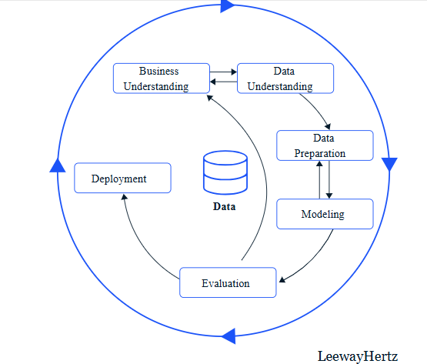
What is AI life cycle?
Let’s explore…

Slide 10
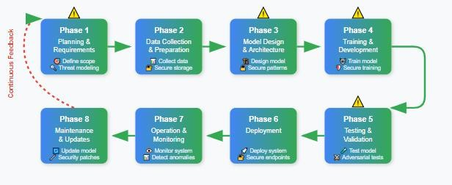
A structured process guiding the development, deployment, and maintenance of AI systems.
Begins with problem identification → ends with updates and
monitoring.

Slide 11
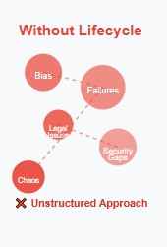
Why Do We Need a Development Lifecycle?
To ensure AI systems are reliable, safe, and ethical.
Prevent failures, bias, and legal violations (e.g., GDPR, ISO 27001).
Organize the development process step by step: plan → build → deploy → monitor → improve.
Enables teams to collaborate and deliver trustworthy solutions.

Slide 12
Key players in AI life cycle
Stakeholders:
Business Leaders → define goals & align with strategy
Data Scientists & Engineers → build & train models
Domain Experts → ensure relevance to real problems
IT & Ops Teams → deploy and integrate systems
End-Users → provide feedback for continuous improvement

Slide 13
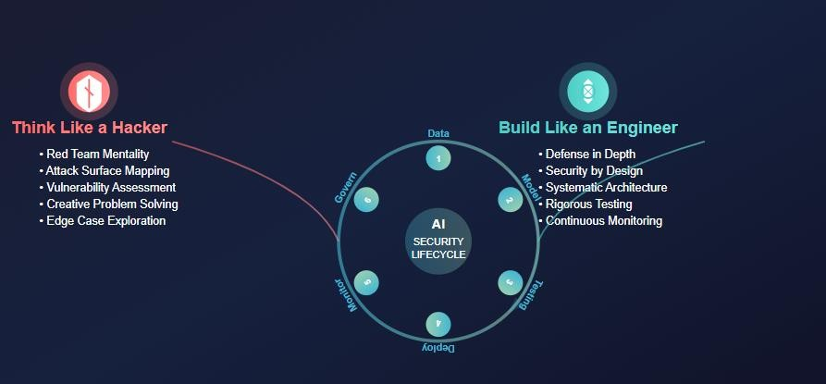
Think Like a Hacker, Build Like an Engineer: Securing the AI Lifecycle
We’ll now walk through each phase of the AI development lifecycle, identifying security risks and how to mitigate them.

Slide 14
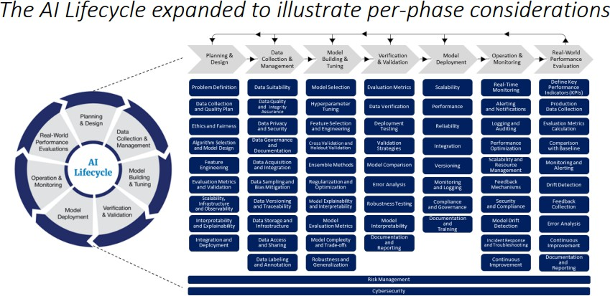
https://www.fda.gov/media/180310/download

Slide 15
Phase 1: Planning & Requirements
The planning phase defines the foundation for the entire AI system. It includes:
Defining the purpose of the AI system.
Understanding the operational context: Where, how, and by whom it will be used.
Identifying stakeholders: Business owners, engineers, legal, security, end-users.
Defining success metrics (KPIs) such as “reduce error rate by 15%”.
Scoping the system to align with business, legal, ethical, and technical needs.

Slide 16
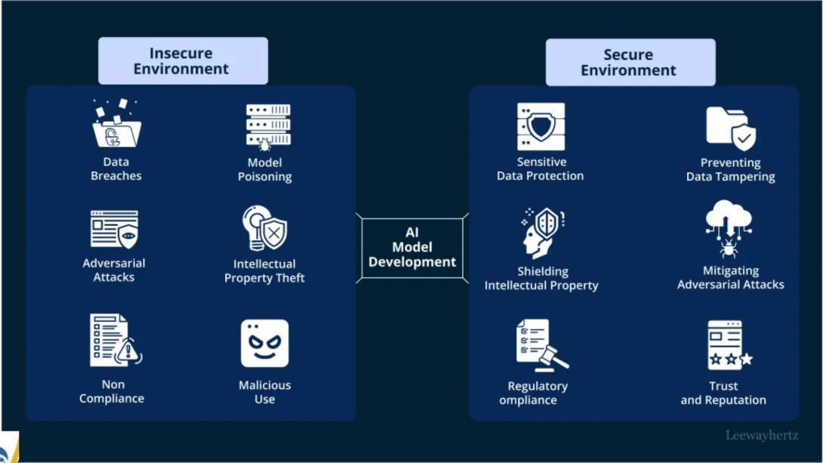
Key Security and Privacy Aspects
Let’s explore…

Slide 17
Deployment environment
Where the AI system will run? :
Cloud , edge , on premise
Cloud =AI runs on remote servers
Edge = AI runs on local device ( exp :smart watch , car ..) On premise =AI hosted on internal company servers

Slide 18

Risks & mitigations
Each deployment option introduces different security risks that must be addressed carefully:
Deployment | Risk | Mitigation
cloud | External cyberattacks, misconfigured permissions | Encrypt data, configure IAM policies, monitor access logs
Edge | Physical tampering, delayed updates | Harden devices, enable remote patching, encrypt storage
On premise | Insider threats, weak monitoring | Role-based access control (RBAC), internal traffic logging, anomaly detection

Slide 19
Degree of Autonomy
Level | Human Oversight | AI Capability
1 (Basic) | Full manual control | Executes fixed tasks
2 (Partial) | Human reviews anomalies | Learns from patterns, limited decisions
3 (Conditional) | AI handles routine tasks | Operates under defined conditions
4 (High) | Strategy-level supervision | Coordinates workflows autonomously
5 (Full) | Optional or strategical | Self-directed AI ecosystems

Slide 20
Risks & mitigations
Level | Risks | Mitigation
1 (Basic) | Rule-based failures | Exception handling + Manual backups
2 (Partial) | Model bias + Data quality | Validation + Human checkpoints
3 (Conditional) | Handoff failures + Boundary issues | Escalation systems + Monitoring
4 (High) | System dependencies + Compliance | Redundancy + Emergency overrides
5 (Full) | Maximum impact + Ethics | Governance frameworks + Security

Slide 21
Output Type
Output = results of AI system
Types of output :
Class / label → classification
Text , prediction , responses → information Calls, physical world action →Action Characteristics:
Content = What the AI produces (data, text, commands) Confidence Level = How certain the AI is about its output

Slide 22
Risks & mitigations
Output Type | Risk | Mitigation
Class Label | Wrong output | Apply confidence thresholds, validate by human
Real-world Actions | Dangerous consequences (,money transfer, door unlock) | Require human confirmation, enforce output verification, logging for critical actions

Slide 23
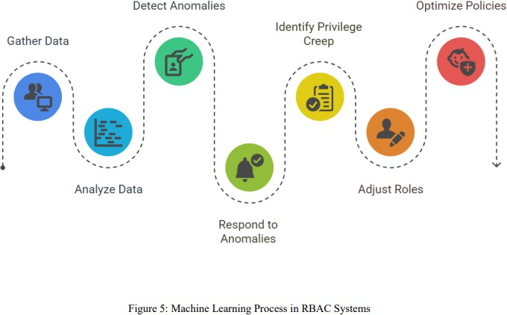
User Access
User access in AI systems refers to the controls and mechanisms that regulate who can interact with the AI, what data they can access, and what actions they can perform.
Risk : Unauthorized access, privilege creep.
Mitigation :
AI-powered Role-Based Access Control (RBAC) MFA & logging
Regular audits and compliance alignment

Slide 24
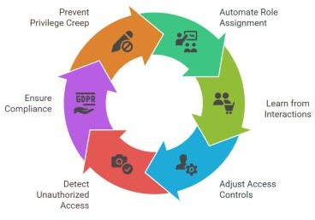
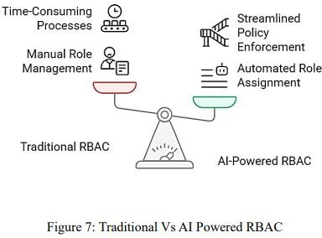
AI-powered Role-Based Access Control (RBAC)
AI analyzes the actual behavior and needs of users to assign the
most appropriate permissions dynamically.
AI-powered RBAC significantly improves efficiency by automating much of the role assignment and policy enforcement processes, reducing administrative overhead and streamlining access management

Slide 25
Consequences of Neglecting Security in the Planning Phase
Poor deployment planning
Undefined Output Controls
Weak user access Policies
Non-Compliance with Regulations( GDPR , HIPAA)
Difficult to fix it later ,more expensive to correct in later stages like deployment or production.

Slide 26
Phase 2 : Data Collection & Preparation
Data collection = Collect the data from various sources to feed AI systems.
First , from where we collect this data ? From multiple source
structured data (databases, spreadsheets)
unstructured data (social media posts, images, videos),
real-time data (IoT devices, sensors, user interactions) from internal and external sources.

Slide 27
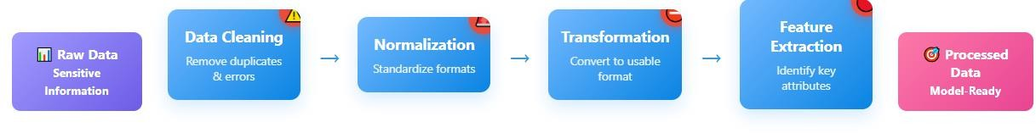
Preparation/CLEANING PHASE
Collected data into a clean, standardized format suitable for AI model training.
Steps for preprocessing:
Handle missing values.
Removing inaccuracies or duplicates
Normalization (standardizing formats)
Transformation (converting data into a usable format).
This step is critical to ensuring the quality of the data used for AI model training.

Slide 28
Key Security and Privacy Aspects
Let’s explore…

Slide 29
Why we should secure this phase ?
AI systems pose unique challenges to data privacy that traditional systems do not
AI can autonomously analyze, infer, and learn from data, potentially
leading to unintended consequences
Personal information is often used in complex algorithms, creating privacy concerns

Slide 30
Types of Data
Includes personal, health, financial, location, and social media data.
Security Risk
Personal Data (names, addresses, emails) used in personalized marketing can be exposed.
Financial Data (bank details, transactions) processed for fraud detection faces theft risks.
Health Data (medical records, biometrics) used in diagnostics must comply with HIPAA.
Location Data GPS, movement patterns
Social Media Data (posts, interactions) analyzed for sentiment may violate user privacy expectations.

Slide 31
Risk & Mitigation
Risk | Mitigation
Personal data (names, emails) exposed | Data anonymization and pseudonymization
Financial data (bank details) stolen | Encryption in storage and transit
Health data (medical records) leaked | HIPAA-compliant encryption and access controls
Location data enables stalking | Differential privacy techniques
Social media posts reveal private info | Data minimization - collect only necessary data
Combined data identifies individuals | Restrict access based on data sensitivity
Violating privacy laws (GDPR, CCPA) | Implement compliance frameworks

Slide 32
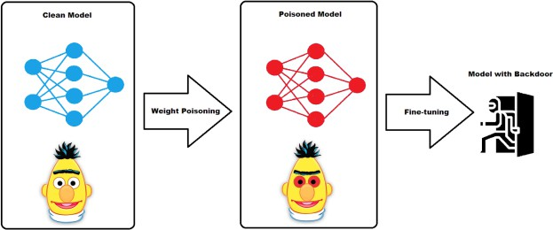
Training Data origins
Where the data comes from (internal databases, third-party APIs)
Risk | Mitigation
Third-party vendors have weak security | Vet external data providers
Malicious data poisoning attacks | Use data integrity checks (hash verification)
Insider threats from employees | Role-Based Access Control (RBAC)
Human error in data collection | Robust data governance policies
Weak security at data sources | Monitor for unusual patterns in data
IoT devices poorly secured | Secure data collection protocols
Insecure APIs expose data | Use secure transfer protocols

Slide 33
Inference data Origins
The data that the system will later receive in production.
Risk | Mitigation
AI combines data to identify people | Apply differential privacy techniques
AI guesses sensitive personal info | Privacy impact assessments
AI makes biased discriminatory decisions | Bias detection and fairness audits
AI reveals more than people shared | Access control policies
AI creates detailed personal profiles | Monitor AI outputs for privacy leaks
Malicious inputs manipulate AI | Validate and sanitize input data
AI accidentally leaks training data | Adversarial testing during evaluation

Slide 34
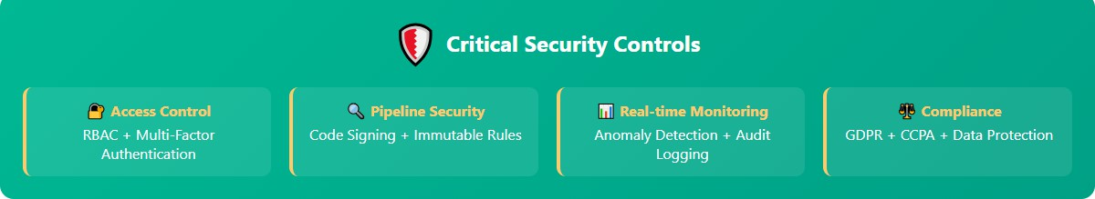
Risk & Mitigation for Processing phase
Phase | Risk | Impact | Mitigation
Data Cleaning | Malicious Data Injection | Model poisoning, biased outcomes | Input validation, source authentication
Normalization | Format Injection Attacks | Code execution, system compromise | Format validation, secure parsing
Transformation | Logic Tampering | Incorrect predictions, model bias | Code signing, immutable rules
Feature Extraction | Feature Poisoning | Security bypasses, discrimination | Feature validation, anomaly detection

Slide 35
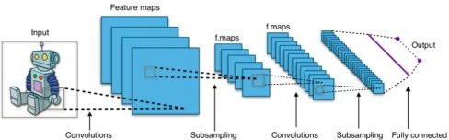
Phase 3:Model Design & Architecture
This phase focuses on choosing and designing the right model and system architecture for AI solution.
This phase include:
Selecting model type: Based on the problem (exp: CNN for image classification, RNN for text, DT for tabular data).
Defining system architecture: How the model will interact with data, APIs, storage, and users.
Choosing learning strategy: Supervised, unsupervised, reinforcement...
Planning modularity and scalability: Ensuring the model can grow and adapt with new data and requirements.
Integration planning: How it connects with existing systems.

Slide 36
Key Security and Privacy Aspects
Let’s explore…

Slide 37
Privacy-Preserving Architecture
Based on CSI Best Practice #8
Differential Privacy: Adds statistical noise to protect training data
Privacy Budget (ε): Controls how much privacy is preserved
Trade-off: More privacy = less accuracy
Challenge: High computational cost

Slide 38
Secure Model Topology
Prevent model inversion (reverse-engineering training data)
Design to avoid encoding sensitive info in model parameters
Ensure gradient protection (no leakage during training)

Slide 39
Foundation Model Security
From CSI Data Supply Chain
Demand assurances from model providers
Verify training data origins
Require formal certification for data/model safety
Avoid models with uncertain provenance

Slide 40
Supply Chain Poisoning Threats
Split-view poisoning risks
Attackers exploit expired or abandoned domains
Can poison datasets for as little as $60
Mitigation:
Choose trusted model providers
Validate data integrity
Monitor the model lineage

Slide 41
Learning Strategies
Federated Learning:
Data stays local
Only updates are shared
Uses secure multi-party computation(SMPC)
Adversarial Training
Protects against malicious data
Techniques:
Ensemble models
Anomaly detection

Slide 42
Secure Training Environment
CSI Best Practice #4
Zero Trust Architecture: Nothing is trusted by default
Secure Enclaves: Isolated environments for data processing
Ensures computational integrity and data confidentiality

Slide 43
Hardware & Data Security
Storage: Use FIPS 140-3 compliant encrypted devices
Encryption:
AES-256 (resistant to quantum threats)
Encrypt data at rest, in transit, and in processing
Data Depersonalization:
Mask sensitive values
Maintain statistical properties
Digital Signatures:
Authenticate data
Track revisions

Slide 44
Risks &Mitigations
Risk | Strategy
Poisoned training data | Require data certification and validation
Model inversion attacks | Use federated learning, gradient protection
Compromised foundation models | Request formal assurances from model providers
Split-view poisoning | Use data hashing, trusted snapshots
Adversarial examples | Ensemble models, anomaly detection
Leakage of sensitive info in parameters | Parameter encryption (AES-256), secure enclaves

Slide 45
Phase 4 : Training & development
During training and development, the AI system is built and optimized. Phase include:
Splitting the dataset:
Training set: Used to teach the model.
Validation set: Used to tune hyperparameters (e.g., learning rate, number of layers).
Test set: Used to evaluate the model’s performance objectively.
Training the model:
Feeding input data and updating weights (if it's a neural network).
Iteratively improving performance.
Hyperparameter tuning:
Adjusting model settings to reduce errors (e.g., batch size, dropout rate).
Preventing overfitting/underfitting:
Regularization, dropout, early stopping.
Evaluation:
Using metrics like accuracy, precision, recall, F1 score, or MSE depending on the task.
Saving trained model:
Exporting the final model for deployment.

Slide 46
Key Security and Privacy Aspects
Let’s explore…

Slide 47
Training Data Origins
Risk:
Malicious or low-quality data can bias or poison the model.
Mitigations (per CSI):
Vet data sources
Use data provenance tracking
Apply anomaly & outlier filtering

Slide 48
Model Origins
Risk:
Pre-trained models (from unknown sources) may include backdoors or malicious triggers.
Mitigations:
Only use trusted repositories
Test for adversarial behavior
Fine-tune using certified datasets

Slide 49
Learning Strategies
Strategy Types:
Supervised, Unsupervised, Reinforcement
Risks:
RL can be manipulated by reward hacking
Unsupervised models may group sensitive attributes together
Mitigations:
Match learning type to problem Monitor learning behavior
Conduct adversarial simulations

Slide 50
Risks &Mitigations
Risk | Mitigation
Data poisoning | Clean data, validate inputs, anomaly detection
Overfitting on PII | Use differential privacy, regularization, model audits
Model compromise | Scan and test pre-trained models, retrain partially
Strategy abuse | Match task to method, monitor for unexpected behavior
Resource abuse | Rate-limit training jobs, use secure cloud infrastructure

Slide 51
Phase 5 : Testing & Validation
Test the model before enter in the real world
Verify AI model accuracy (Accuracy, Precision, Recall, F1 Score (for classification), MSE, RMSE (for regression))
Detect vulnerabilities like bias , drift , error
Testing &Validation Activities: Adversarial testing/red-teaming
Performance validation: metrics on unseen data Bias and fairness evaluation
Safety and robustness assessments Model behavior drift testing over time

Slide 52
Risks & Mitigations
Risk | Mitigation
Model drift over time | Drift detection; automated triggers and alerts
Adversarial exploits discovered post-deployment | Red-teaming and adversarial simulations before release
Deployment without validation | Formal evaluation steps with metrics/gates
Incident not detected promptly | Real-time monitoring, logging, rollback mechanism

Slide 53
Phase 6 : Deployment
The model enter finally in the production life ( Real world)
Risks in this phase : Unauthorized access Misconfiguration Model inversion
Risks from the deployment area
Area | Risk | Mitigation
cloud | External attacks | Use secure channel (exp: HTTPs ,VPN)
Edge | Physical access | Apply secure boot and physical protection
On premise | Threat from the inside of company | Encrypt files ,access control

Slide 54
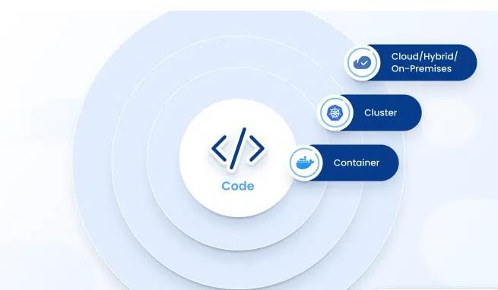
Risk from Model packaging
First, we containerize the AI model using tools like Docker and then deploy it using Kubernetes.
Each of these steps introduces its own security risks, starting from securing the data before containerization
Docker = container includes everything the AI model needs to run: code, dependencies, libraries, and configuration files
So , it’s essential to ensure that all in the container is secure

Slide 55
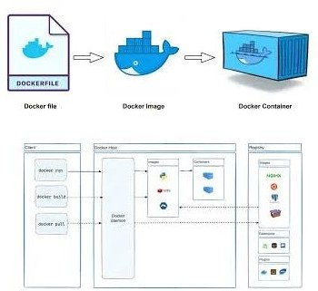
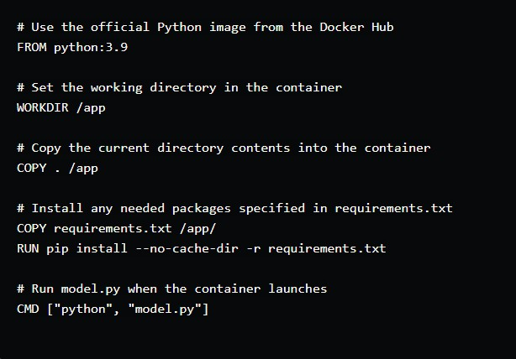
How Docker Works???
From code to container
Docker file :text file define how we build the ai model Exp :
Docker image :Read-only templates used to create containers. They include the application code, libraries, and dependencies. Run using
→ docker build -t mymodel
Docker container :The Running App , run using → docker run
mymodel
55

Slide 56
Risks &Mitigation
Risk | Mitigation
Vulnerable base image | Use official & minimal images + scan with Trivy
Secrets in images | Use Docker secrets or environment variables
Run container as root | Add non-root user in Dockerfile
Unrestricted container network | Use isolated Docker networks
Outdated dependencies | Automate updates using Dependabot or Renovate
No runtime monitoring | Use Prometheus, Grafana, or Falco to detect anomalies
https://dev.to/docker/container-security-best-practices-for- aiml-projects-ac

Slide 57
Kubernetes
After we use Docker to containerize our AI model, we use Kubernetes to deploy, manage, and scale those containers automatically
Kubernetes is an open source used for managing containers
Dockers → make boxes
Kubernetes →Move, launch, control thousands of boxes

Slide 58
How Kubernetes works?
When deploy a Kubernetes we get a clusters , clusters contains control panel ,Nodes (worker)
Control Panel =brain of the system
Control Panel components
Component | Function
kube-apiserver | Exposes the Kubernetes API (entry point to the system)
etcd | Stores all cluster data (key-value database)
kube-scheduler | Decides which node runs each Pod
kube-controller-manager | Ensures the desired state is maintained
cloud-controller-manager | Connects Kubernetes to cloud platforms (e.g., AWS, GCP)

Slide 59
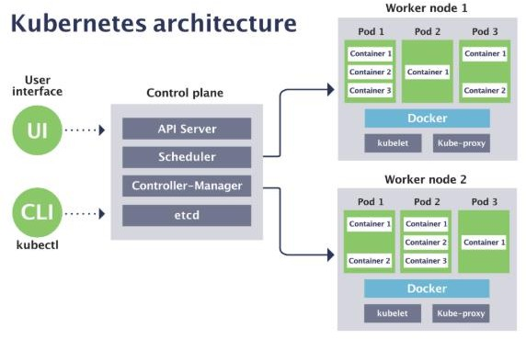
Nodes =machines that run the containers
Component | Function
kubelet | Ensures containers inside Pods are running properly
kube-proxy | Manages networking and service communication
container runtime | Runs the actual containers (e.g., Docker, containerd)

Slide 60
Risks & Mitigations
Risk | Mitigation
Misconfiguration | Implement verification tools (Kubval), RBAC
Insecure container images | Use signed and trusted images, scan with tools like Trivy or Clair
Inadequate network segmentation | Define strict NetworkPolicies, apply default deny rules, use Calico or Cilium for enforcement
Exposed Kubernetes API endpoints | Secure with TLS, enable strong authentication, use API gateway with rate-limiting
Supply chain attacks in CI/CD | Enable image signing (e.g., Sigstore, Cosign), verify build sources, and scan CI/CD pipelines
Lack of real-time monitoring | Deploy runtime threat detection tools like Falco, use Prometheus & Grafana for metrics and alerting

Slide 61
Phase 7 : Monitoring
After the model enter running in the real world, goal here is to make sure it performs well and stays aligned with ethical standards at all time
Responsibilities include:
Continuously monitoring the performance of AI model Detect model drift
Logging prediction( output of the system ) , input metadate (input , date ..) and the system behavior.

Slide 62
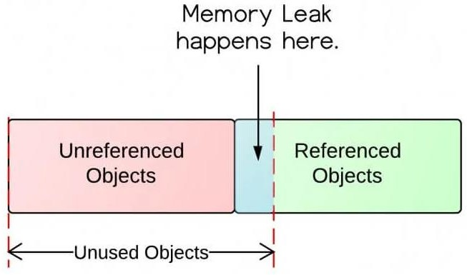
Monitoring using Prometheus & Grafana
Prometheus= open source tools used for detect and mitigate memory leaks in application
What ‘s memory leaks?
When the program allocates memory but fails to release Prometheus collect the metrics from the
application ( CPU , use of memory , nb of Users , time to response, nb of pod restarts)

Slide 63
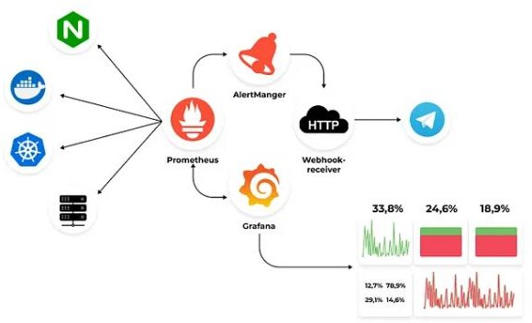
Grafana
After the Prometheus collect all the metrics , Grafana help us to visualize all this metrics in graphs
Also , Prometheus can send an alerts for the anormal behavior of ai model

Slide 64
Phase 8 :Maintenance & Update
It is not the end , it ‘s a phase continuously monitoring for improve the
behavior of Ai system
We do updates but make sure that you have always a copy of version
We can do it using tools like MLFlows , DVC to keep the old version is stored securely , allowing easy rollback and comparaison between different iterations.

Slide 65
Risks & Mitigations
Risk | Mitigation Strategy
Model degradation due to outdated data or changing equipment behavior | Continuously retrain AI models using updated sensor and operational data to reflect current equipment state.
Poor data quality (missing, noisy, or erroneous sensor readings) | Implement robust data preprocessing techniques including cleaning, normalization, and feature engineering.
Overfitting during training phase | Use validation techniques ( cross-validation) and test models on unseen data to ensure reliability.
Difficulty in integrating updated models with existing legacy systems | Develop modular architectures and pilot deployments before full- scale integration.
Model (balck box) the users don’t know why the ai do it | Apply explainability ai
Changing operational conditions ( environment or maintenance policy shifts) | Set up continuous feedback loops and schedule regular model evaluation and update cycles.

Slide 66
Thanks !!

